Slide 1
FINAL PROJECT WORK
KFS Microsoft Program
BY Arwa Ahmed

Slide 2
01
Database Design & ERD
02
SQL
CONTENTS
03
Power Bi

Slide 3
Database Design & ERD
PART 01
Using Drow.oi

Slide 4
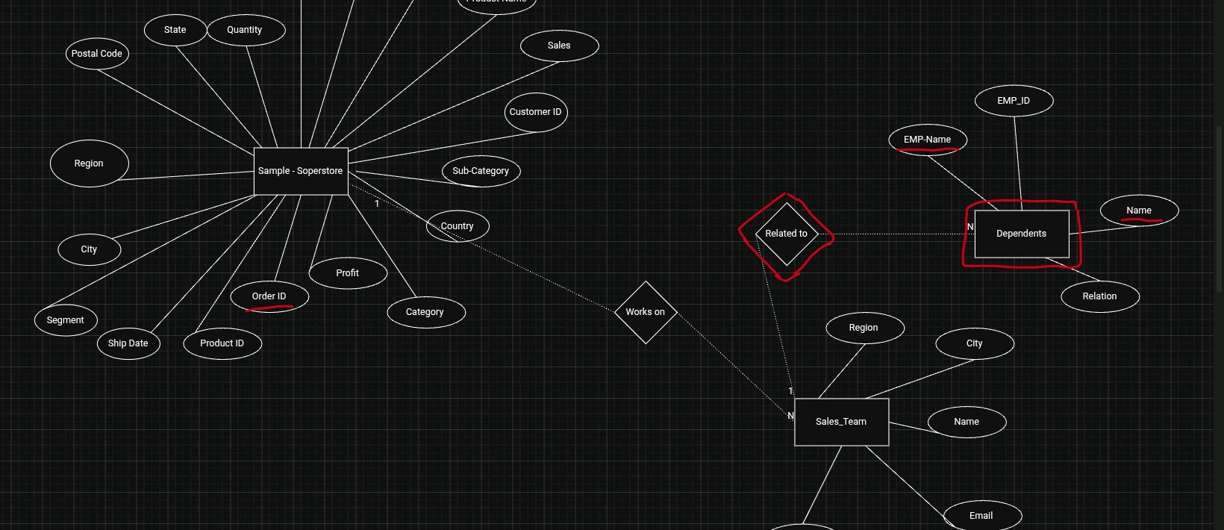
Sample - Soperstore: [21 coloumns, Order ID(PK)]
Sales_Team: [5 coloumns, EMP_ID(PK),Region(FK)]
Dependents: [4 coloumns, EMP_ID + D_Name(PK), EMP_ID ,EMP_NameFK]

Slide 5
SQL
PART 02
Sql server DPMS

Slide 6
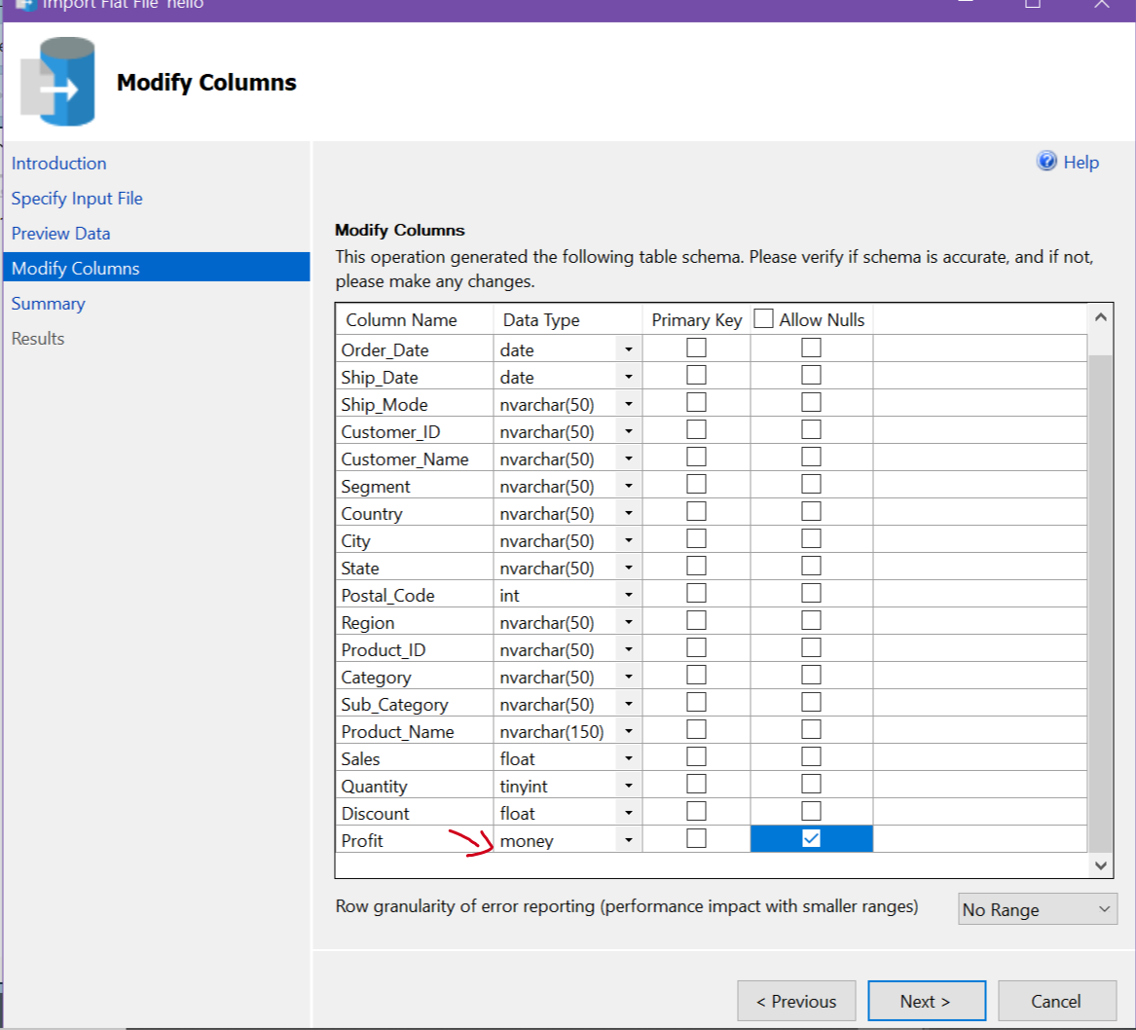
Import the data and verify the data type and null values.

Slide 7
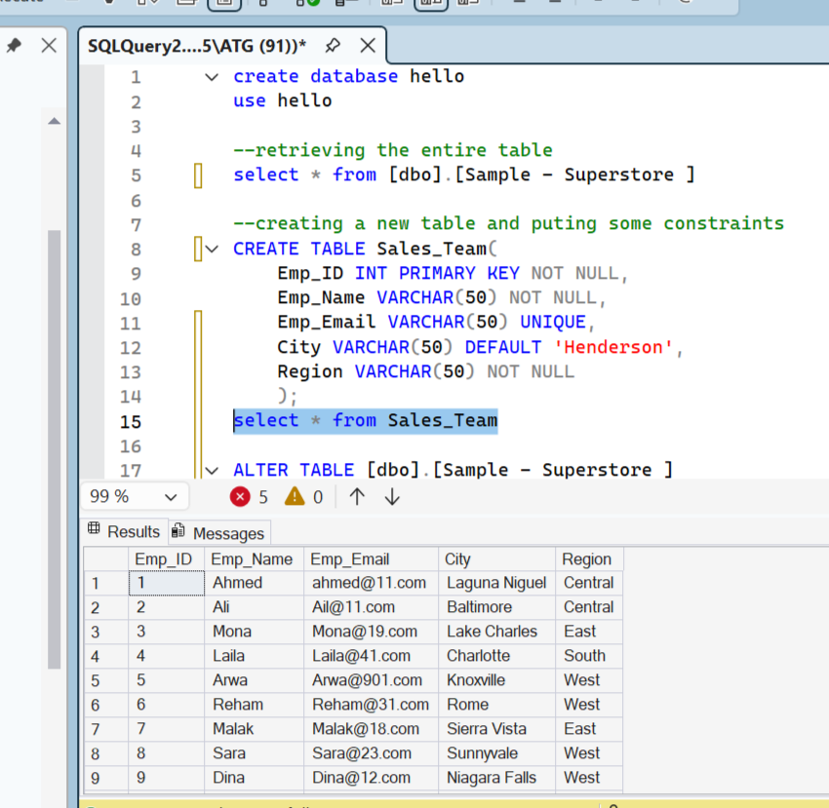
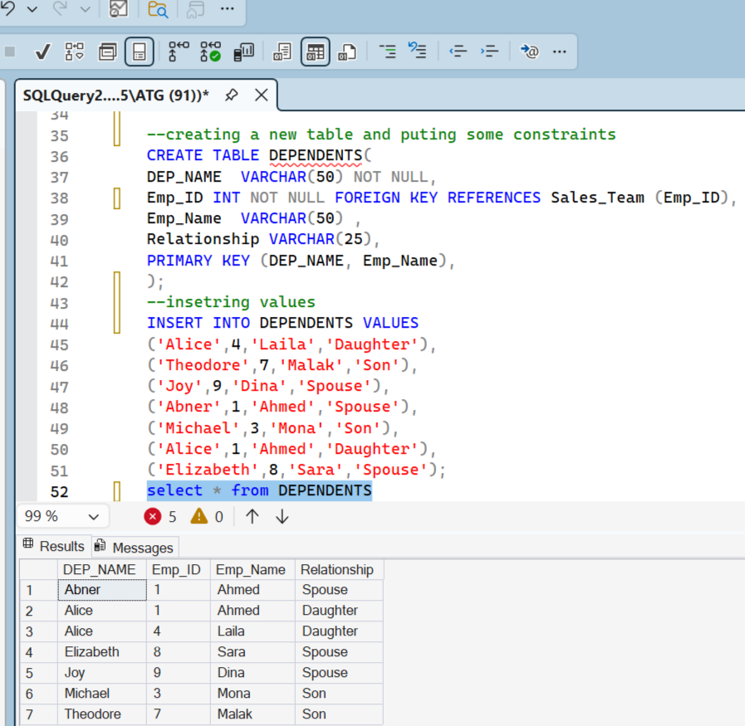
Create Sales_Team table with constraints and insert data
Create Dependetstable with constraints and insert data

Slide 8
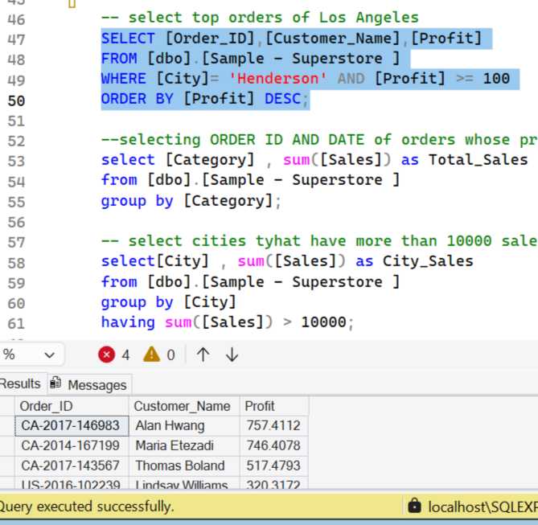
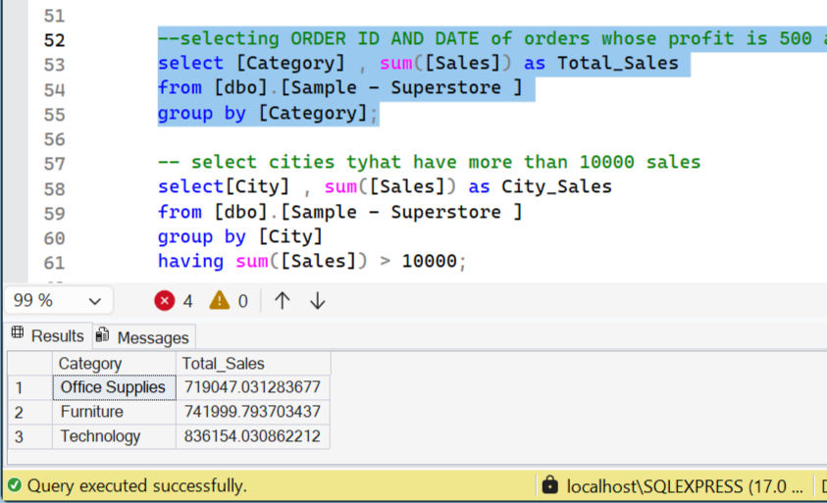
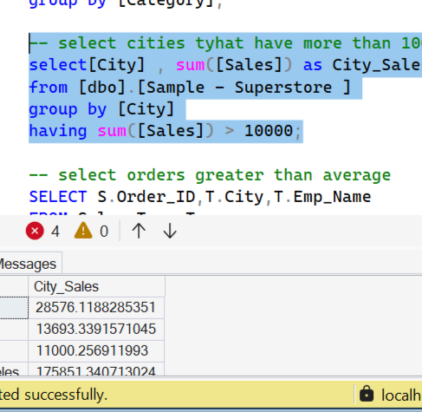
2. Select Total sales per category using
GROUP BY
1. Select all orders in Los Angeles with profit 100 or higher using
WHERE
3. Select cities that have earned over $10,000 using
HAVING

Slide 9
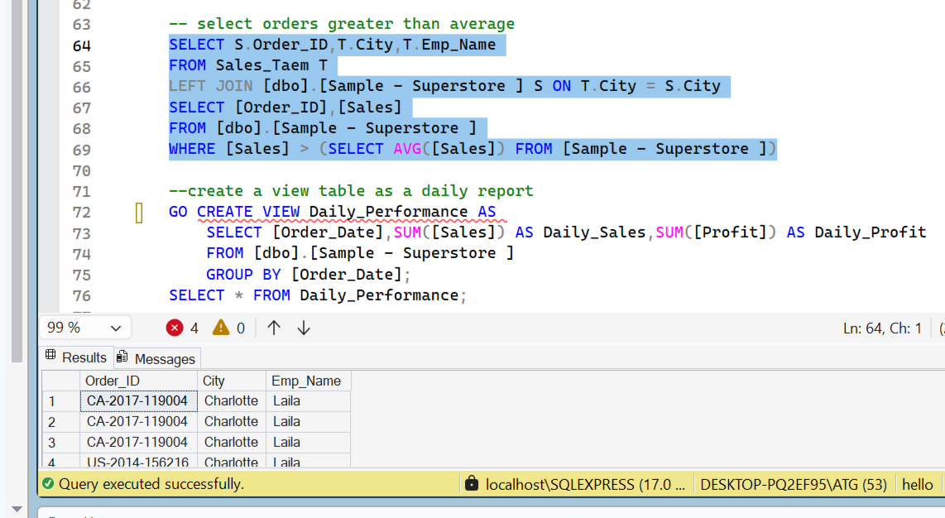
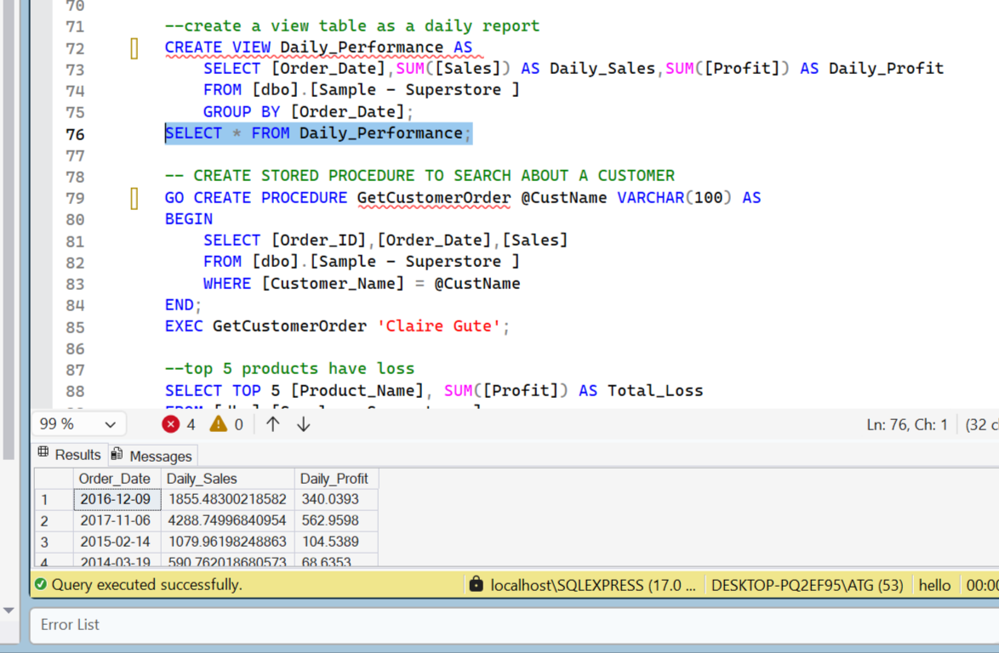
4. Select all orders above average using
sub-queries
5. Create a view of daily reports for easy retrieval using
Views

Slide 10
POWER BI
PART 03
Microsoft power bi

Slide 11
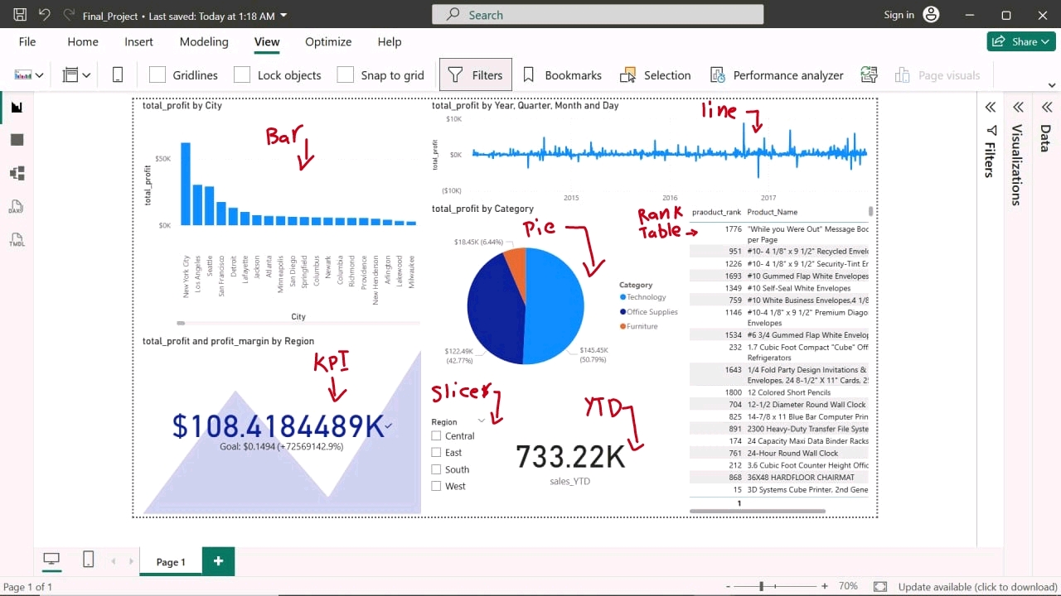
Click here to add to the title

Slide 12
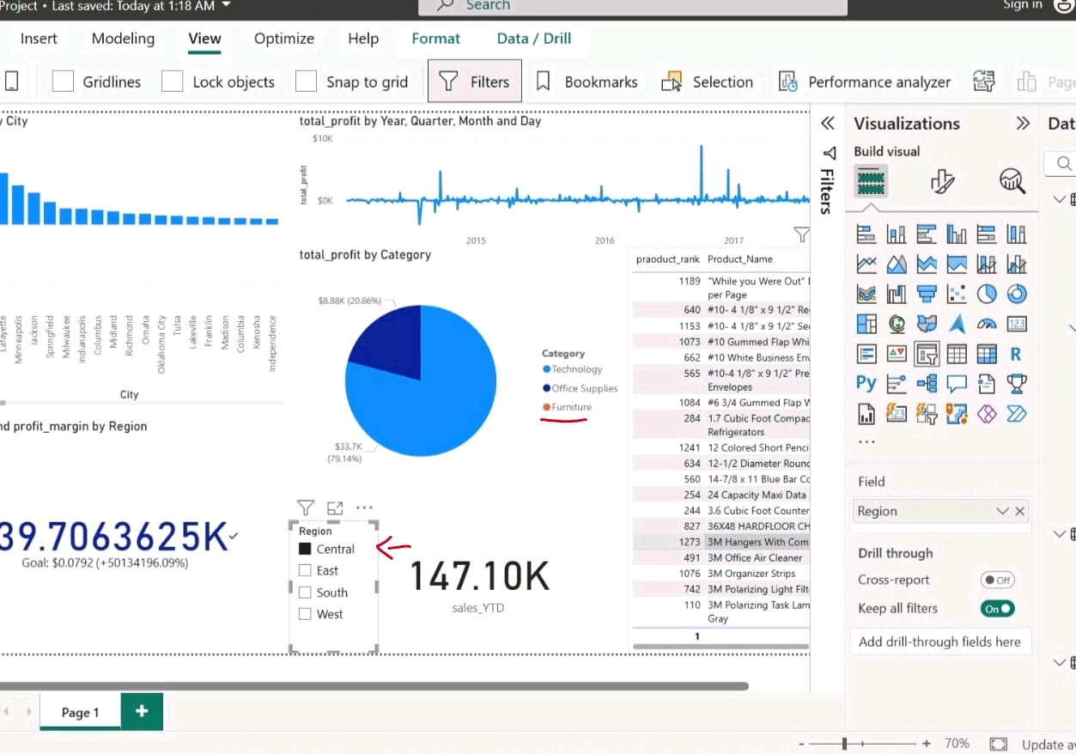
Click here to add to the title

Slide 13
THANKS

